Slide 1
Presented by: Arushi Gupta
Attendance management system using face recognition

Slide 2
1. Traditionally attendance is marked manually by teachers and they must make sure correct attendance is marked for respective student. This whole process wastes some of lecture time and part of correct information is missed due to fraudulent and proxy cases. 2. Face Recognition is a biometric method of identifying an individual by comparing live capture with the stored record for that person. 3. Face Recognition Attendance System is marking of attendance based on this technology.
INTRODUCTION

Slide 3
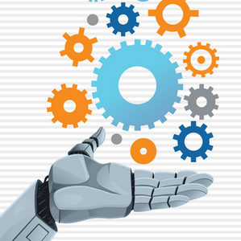

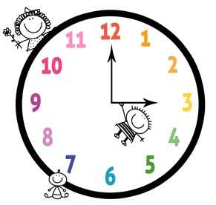

significance
Effective
Automated
Economically
Keep extra time

Slide 4
Technology used
OPENCV-OPEN SOURCE
COMPUTER VISION
tkinter GUI interface
PYTHON

Slide 5
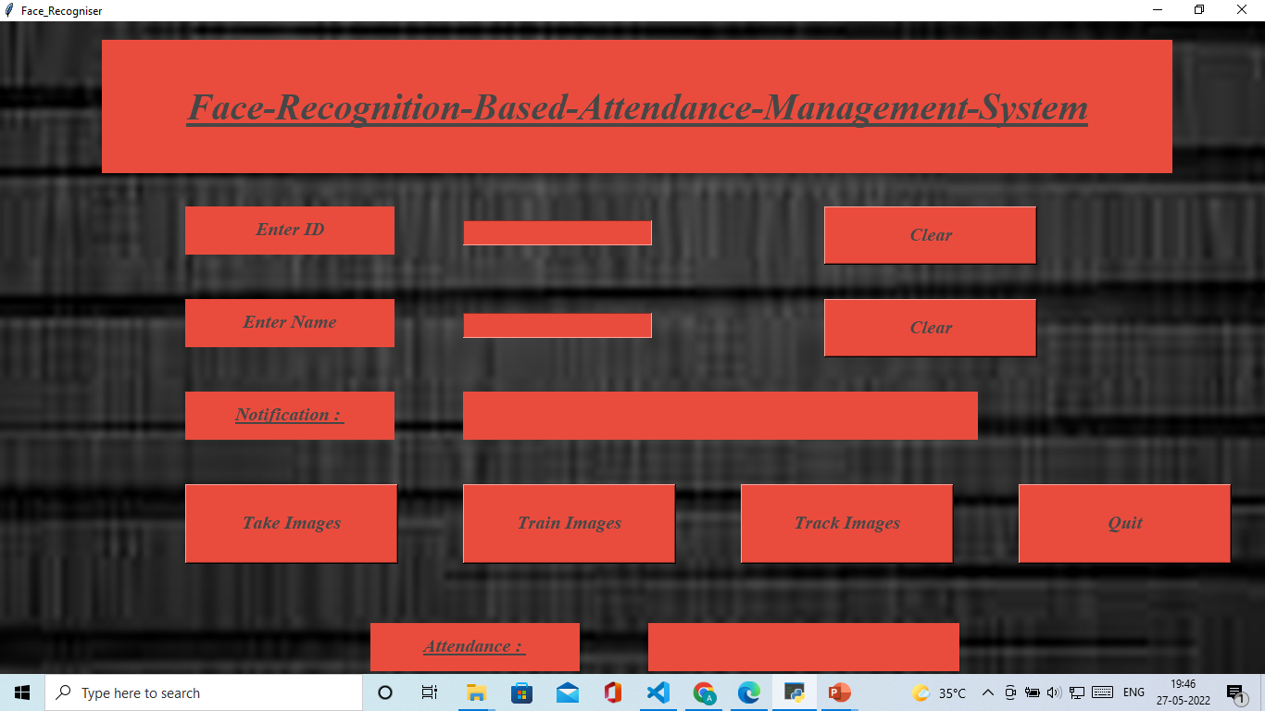
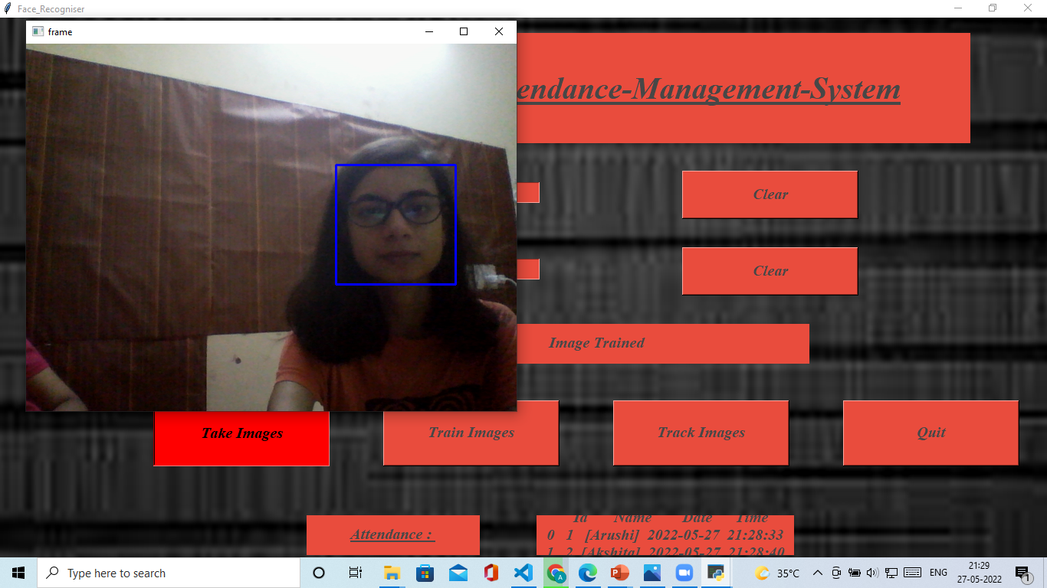
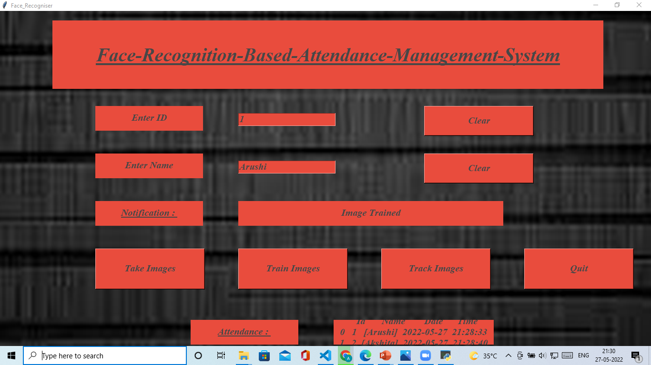
STEP -1
Registration of a student and its face .

Slide 6
1. Enter Id and Enter Name for the student you want to register. 2.We have to click Take Images button. By clicking Take Images camera of running computer is opened and it start taking image sample of person.This Id and Name is stored in folder StudentDetails and file name is StudentDetails.csv. It takes 60 images as sample and store them in folder TrainingImage.After completion it notify that images saved. 3. After taking image sample we have to click Train Image button.Now it take few seconds to train machine for the images that are taken by clicking Take Image button and creates a Trainner.yml file and store in TrainingImageLabel folder.
CONTD…..

Slide 7
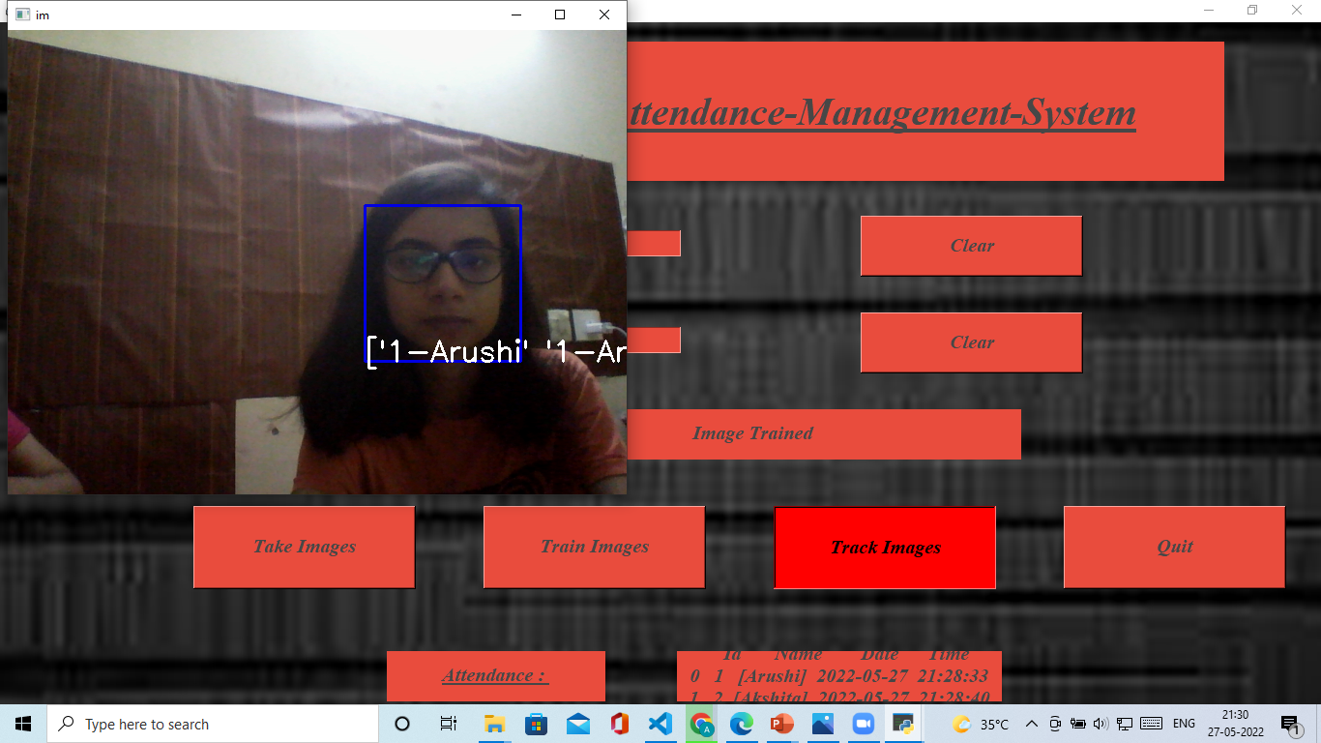
STEP -2
RECOGNITION OF A FACE AND ATTENDANCE UPDATION.

Slide 8
1. Now all initial setups are done. By clicking Track Image button camera of running machine is opened again. If face is recognised by system then Id and Name of person is shown on Image. Press Q(or q) for quit this window. After quitting it attendance of person will be stored in Attendance folder as csv file with name, id, date and time and it is also available in window.
CONTD…..

Slide 9
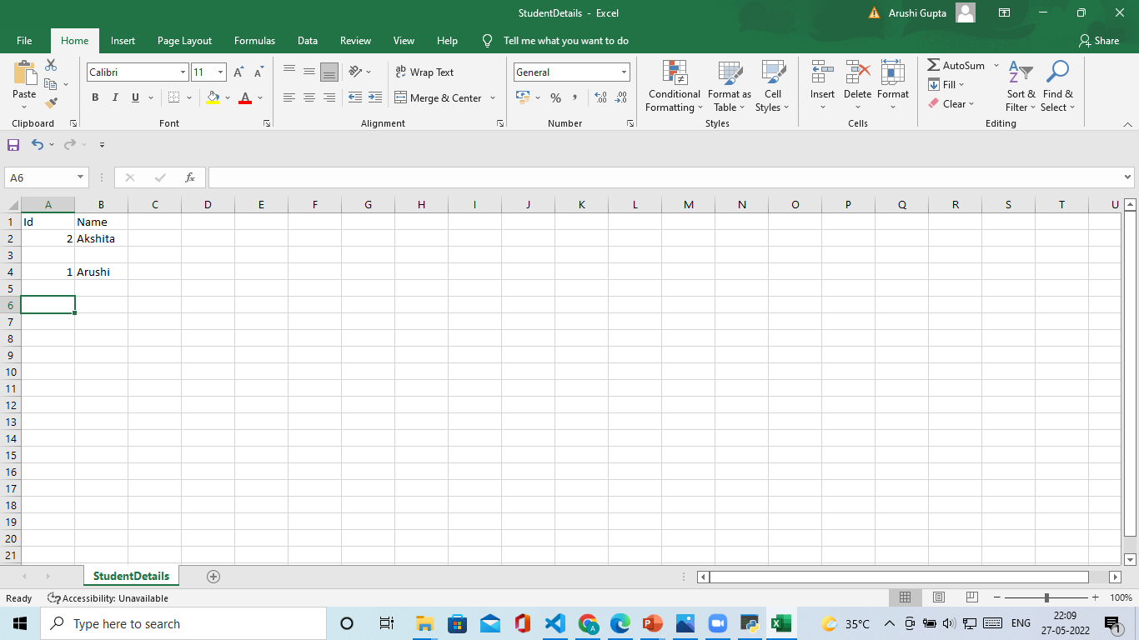
Student details

Slide 10
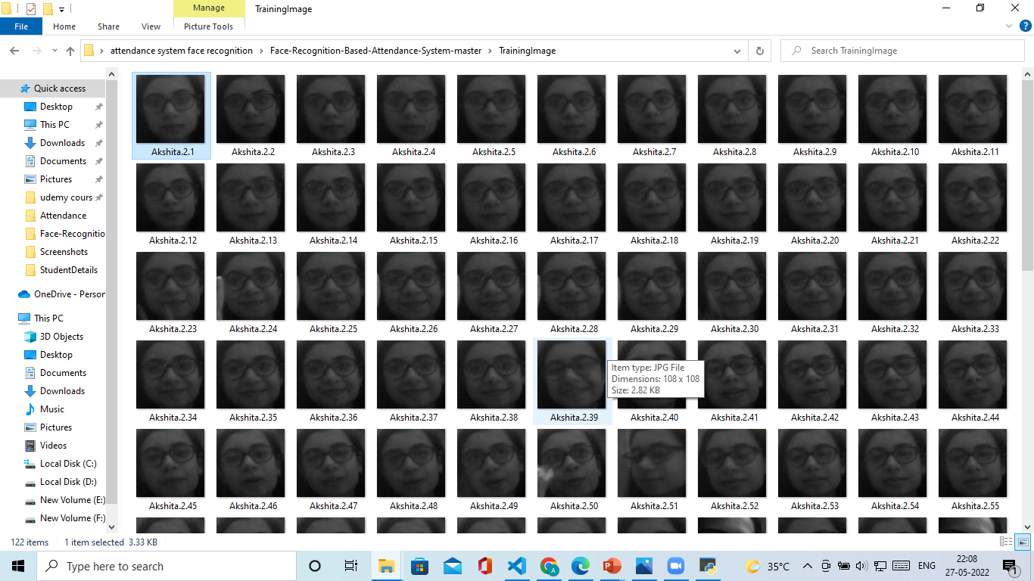
Training images folder

Slide 11
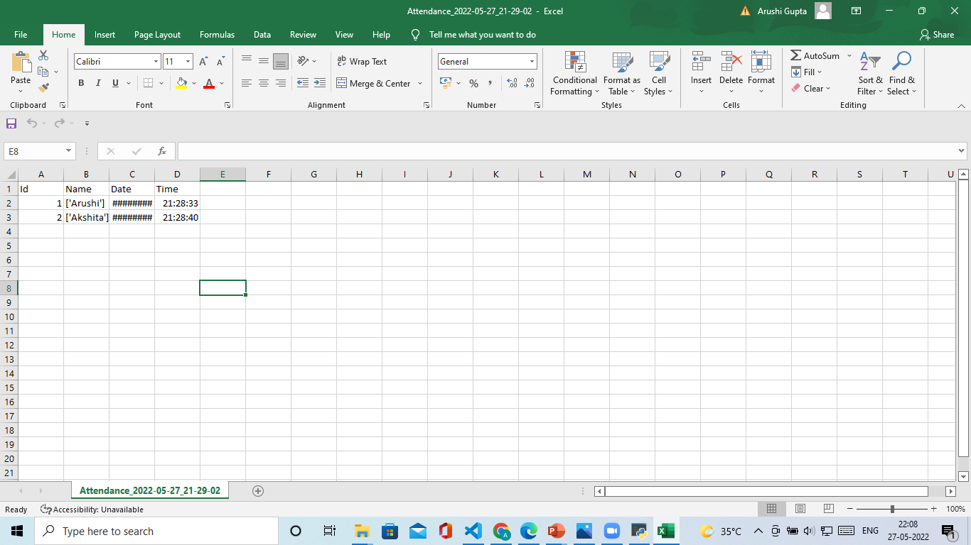
Attendance record at a Time

Slide 12


